Slide 1

sentiment analysis hotel reviews
Presented by:
Rashid Alsumaydi
Abdulelah Aldossari
Majed Alghamdi

Slide 2

methodology
Introduction
Data Gathering
Text Preprocessing & Data visualization
Modeling
Conclusion

Slide 3

Introduction
Hotels play a crucial role in travelling, and with the increased access to information new pathways of selecting the best ones emerged.
With this dataset, you can explore what makes a great hotel and maybe even use this model in your travels!

Slide 4
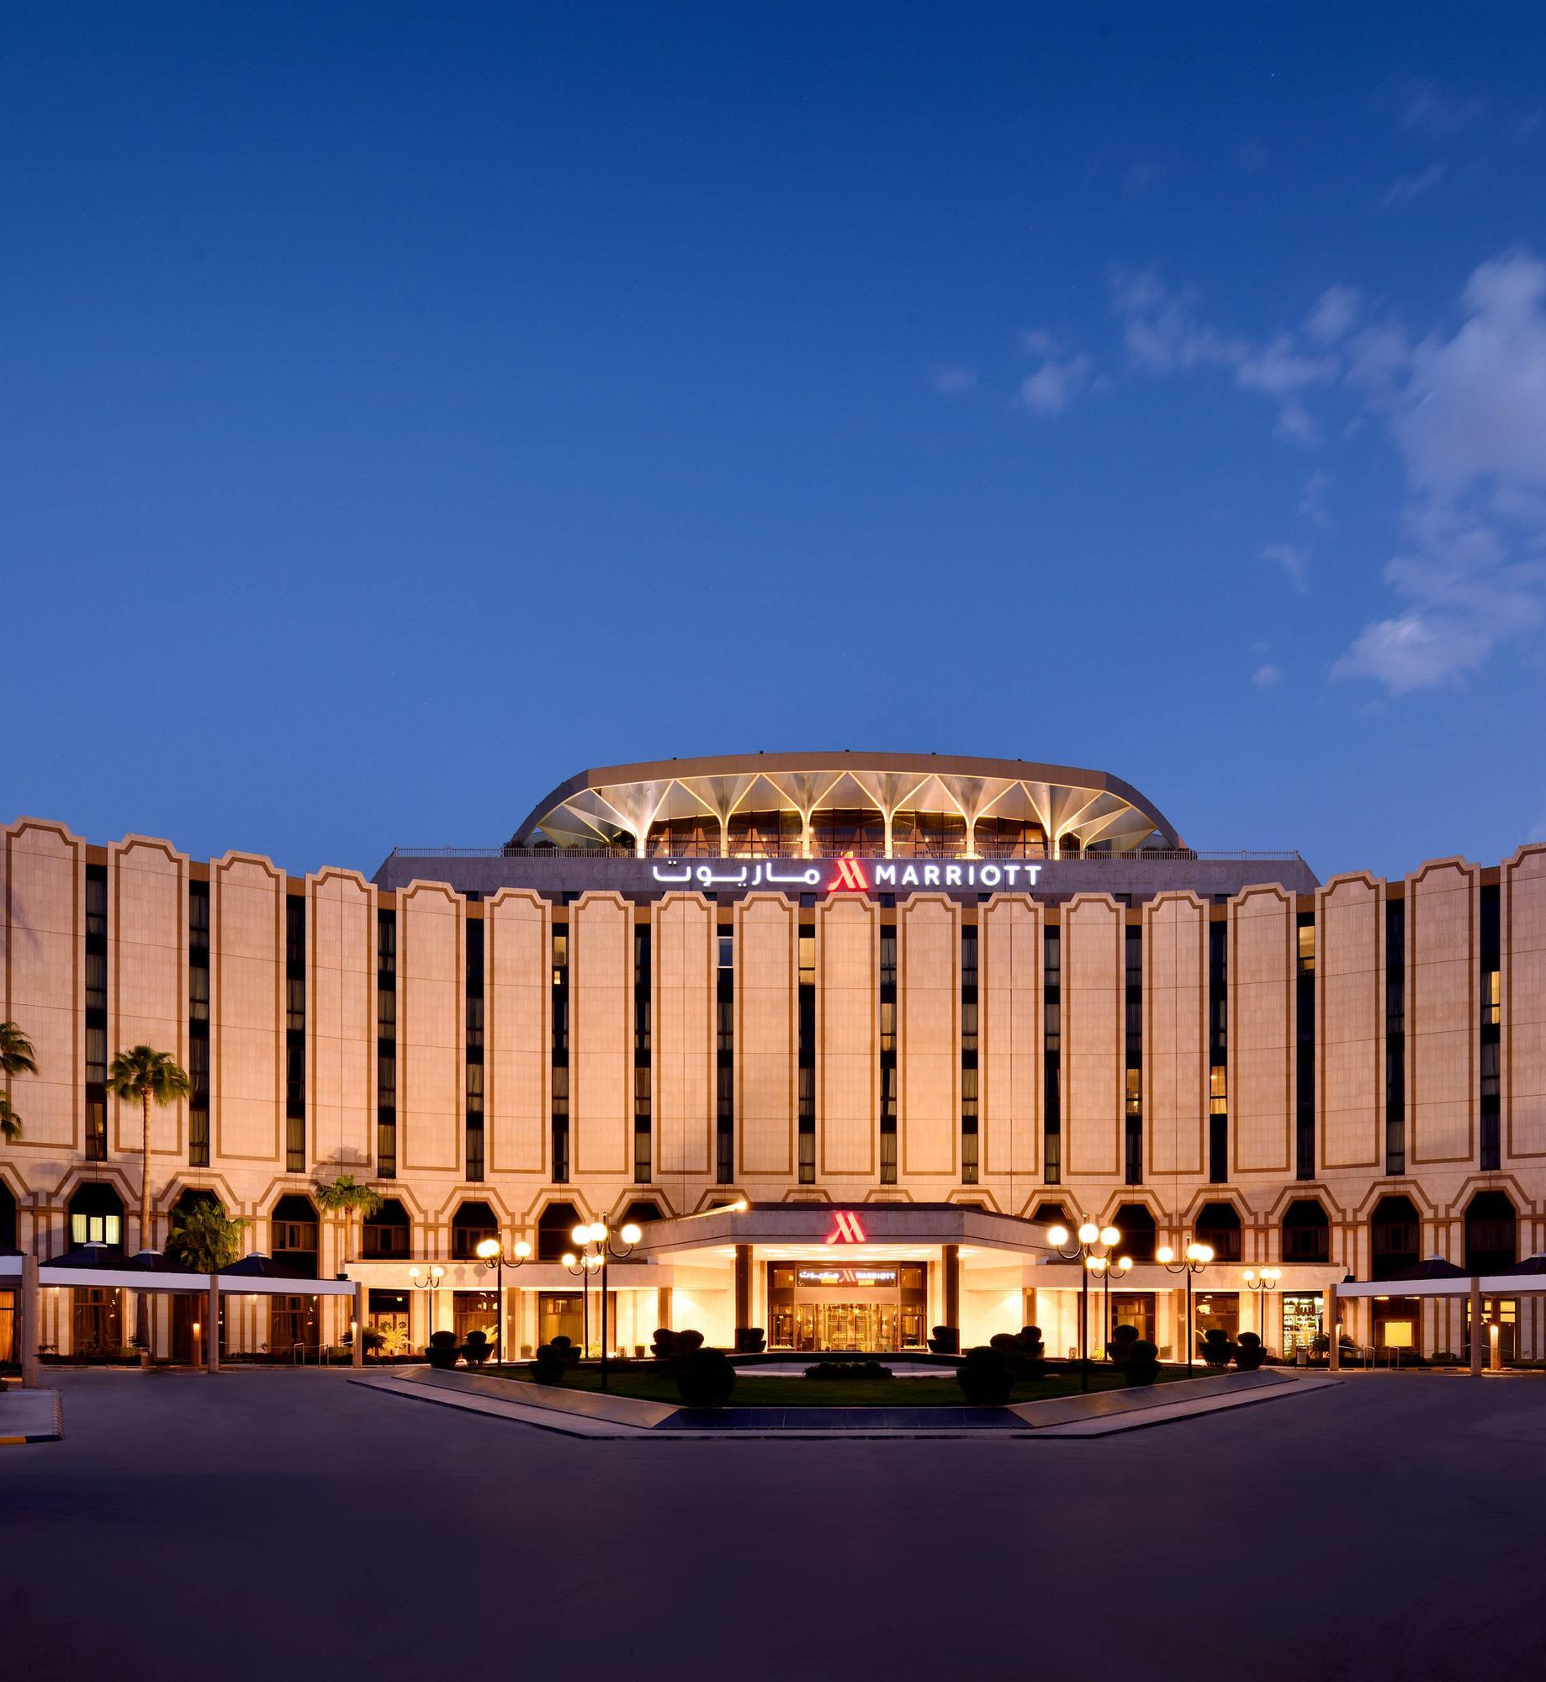
About Dataset
It is called Trip Advisor Hotel Reviews
Contains 20k hotel reviews

Slide 5

text preprocessing
Text Cleaning
K-Means Hyperparameter Tuning
Data Visualization
Supervised Learning
Unsupervised Learning

Slide 6
K-Means Hyperparameter Tuning
n_clusters = 2
max_iter = 100
n_init = 1
K-Means parameters

Slide 7
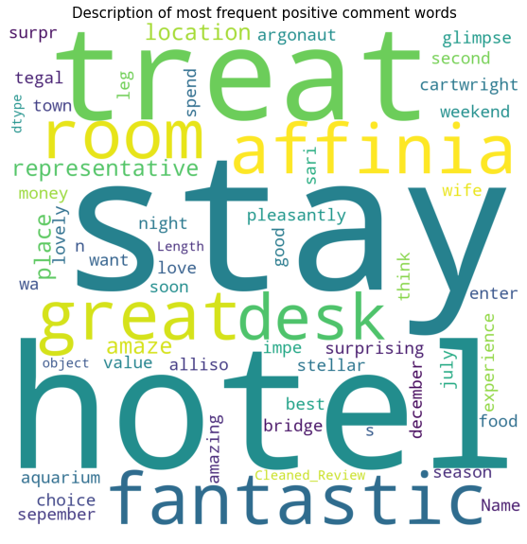
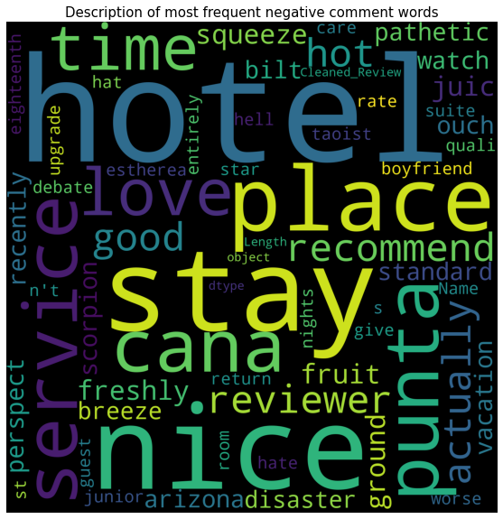
Data Visualization
Supervised learning
most frequent words in each rating

Slide 8
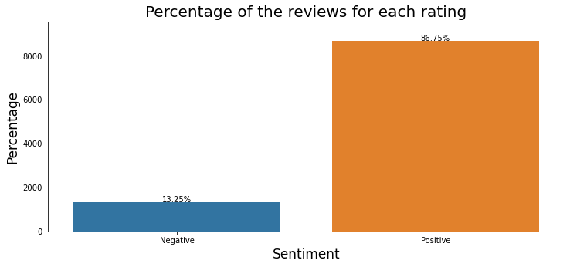
Data Visualization
supervised learning
Distribution of each rating

Slide 9
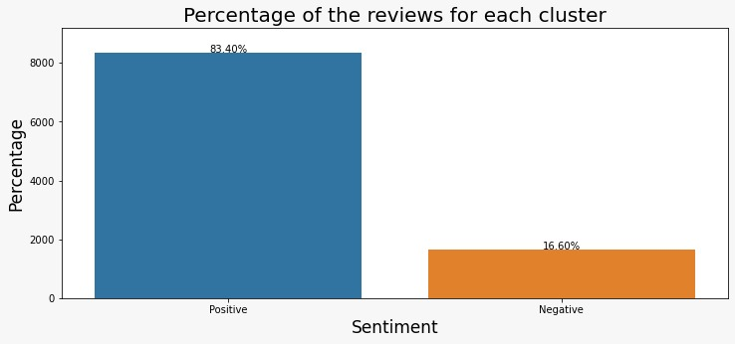
Data Visualization
unsupervised learning
Distribution of each cluster

Slide 10

Modeling
Resampling Methods
Models Used
Results of best models
Supervised Learning
Unsupervised Learning
Hyperparameters of the best model
Supervised Learning
Unsupervised Learning

Slide 11
Resampling Methods
Resampling
Oversample
Undersample
SMOTE
NearMiss
SMOTENC
Random Undersampler
ADASYN
SVMSMOTE
Random
Oversampler
BorderlineSMOTE
Combine
SMOTEENN
Resampling Methods used

Slide 12
Models used
Logistic Regression
Decision Tree
LightGBM
SVM
XGBoost
Random Forest
CatBoost
Ridge Regression
Extra Trees
MLP

Slide 13
Results of best models
Supervised Learning
Model | Class | Precision | Recall | F1-score | Macro Avg (Recall)
Logistic Regression | Negative | 0.94 | 0.96 | 0.95 | 0.98
 | Positive | 0.99 | 0.99 | 0.99
CatBoost | Negative | 0.86 | 0.93 | 0.90 | 0.95
 | Positive | 0.99 | 0.98 | 0.98
LightGBM | Negative | 0.90 | 0.91 | 0.90 | 0.95
 | Positive | 0.99 | 0.99 | 0.99
MLP (hidden_layer_sizes=8, max_iter=50 activation='relu’, solver='adam') | Negative | 0.96 | 0.93 | 0.95 | 0.96
 | Positive | 0.99 | 0.99 | 0.99

Slide 14
Results of best models
Supervised Learning
Classifier | Parameter | Vectorizer | Resampling
Logistic Regression | Penalty: L2 Solver: lbfgs C: 0.6 | TfidfVectorizer | Random over sampling

Slide 15
Results of best models
unsupervised Learning
Model | Class | Precision | Recall | F1-score | Macro Avg (Recall)
Logistic Regression | Negative | 0.94 | 1 | 0.97 | 0.99
 | Positive | 1 | 0.99 | 0.99
Support Vector Machine | Negative | 1 | 0.94 | 0.97 | 0.97
 | Positive | 0.99 | 1 | 0.99
XGBoost | Negative | 0.94 | 0.95 | 0.95 | 0.97
 | Positive | 0.99 | 0.99 | 0.99
LightGBM | Negative | 0.94 | 0.95 | 0.95 | 0.97
 | Positive | 0.99 | 0.99 | 0.99

Slide 16
Results of best models
unsupervised Learning
Classifier | Parameter | Vectorizer | Resampling
Logistic Regression | Penalty: L2 Solver: lbfgs C: 0.6 | TfidfVectorizer | Random over sampling

Slide 17







Tools
TensorFlow
Numpy
Natural Language Toolkit
Pandas
Seaborn
Scikit Learn
Jupyter notebook

Slide 18
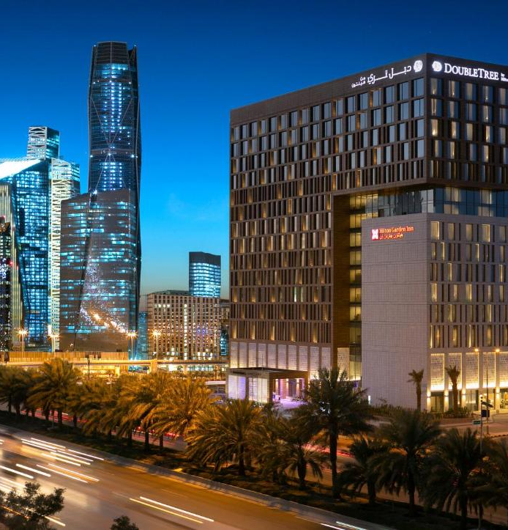
CONCLUSION
We worked on this project in two cases, which are supervised learning and unsupervised learning.
In building models:
Supervised learning, the “Rating” column was used to create “Sentiment_Supervised” column, and then used as a target.
Unsupervised learning, 'cluster' column was used to create 'Sentiment_Unsupervised' column, and then used as a target.
The resampling methodology that was used helped in terms of some important metrics, such as accuracy and recall.

Slide 19

Thank you

